Slide 1
Massachusetts Fair Share Amendment Signature Gathering Training

Slide 2
Fair Share Amendment
The MA Constitution mandates a flat income tax. This amendment:
Applies only to Massachusetts taxable income over $1 million
Applies an additional 4% rate to only this income over $1 million
This will affect less than 1% of all Massachusetts households
Will raise over $1 billion in new, annual revenue
New revenue is dedicated to education and transportation
Notes:
These are the essential features of the Fair Share Amendment.

Slide 3
Campaign Timeline
Early Sept 2015 – Signature Collection Begins.
2015
Nov 18, 2015 – at least 100,000 signatures due at City and Town Clerks
By Dec 2 2015 –at least 64,750 certified signatures due to Secretary of State
2016
January – May 2016 – Must receive 25% of vote of joint session of legislature
2017
January 2017 – May 2018 – Must receive 25% of vote of joint session of legislature
2018
November 6, 2018 – issue goes before voters

Slide 4
Support for the amendment increases sharply at $1M
% Support Amendment
Additional Tax
“The Top 1%” draws support at about the $500k level
$500k
$600k
$700k
$850k
$1M
Income Threshold
Revenue ($B)
1.90 | 1.79 | 1.54 | 1.40 | 1.27
2.35 | 2.18 | 1.83 | 1.69 | 1.57
2.44 | 2.27 | 1.95 | 1.78 | 1.66
2.80 | 2.55 | 2.30 | 2.07 | 1.94
Notes:
What is the entire state budget?
How much does the state spend on public ed?
How much does the state spend on transportation?

Slide 5
Notes:
This campaign at its core is truly about fairness and opportunity for everyone. But fairness and opportunity have been lacking in recent decades for many Massachusetts families.
In the last thirty years, income growth for most Massachusetts families has been relatively weak. Real incomes (i.e., adjusted for inflation) for the Bottom 99% have grown at an annual rate of less than half a percentage point a year or about 14% over this entire period. That’s slow growth.
Incomes of the Top 1% of Massachusetts households, by contrast, have grown 10 times faster or by about 275% over the same period, almost tripling their real income.
But this isn’t how it has to be and it’s not how it always has been. In the thirty year period following WWII, the American economy delivered broadly shared prosperity, with strong income gains for MANY working families at all income levels.
The highest income Massachusetts families have seen their incomes skyrocket over the last three decades, while the incomes of most working families have grown slowly if at all.

Slide 6
Notes:
Asking these highest income families to pay an extra 4% on their taxable income above $1 M - the same families whose incomes have grown so much in recent years and who pay a smaller share of their income in state and local taxes than the rest of us do – is a fair way to raise significant new revenue.
The Fair Share Amendment allows Massachusetts to invest in a prosperous future for all of us AND makes our tax system more fair.

Slide 7
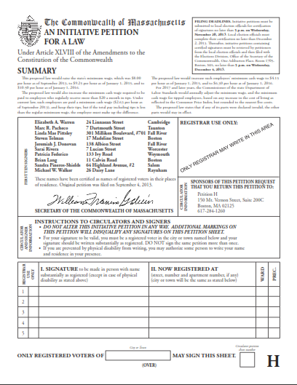
Collecting Signatures
Collect Signature of only registered voters
Signatures on each sheet need to all be form the same city/town.
Put the city at the bottom on BOTH SIDES – don’t leave it blank
If someone has a crazy signature – ask them to print their name in the same box!
People only need to write their street address.
You don’t need Ward & Prec.
John Smith
Somerville

Slide 8
How to screw up a petition
(FAIR SHARE)
Any thing at all in the petition summary is the biggest problem – underlining, highlight, scribbling, etc.
Helpful notes – actually not helpful.
Don’t drink your coffee while you’re out there.
Beware the pen warming zone.
Look out for the crosser outers.
Don’t get greedy – bank a petition
after 8-10 signatures.
John Doe 23 Smith St.

Slide 9
What’s Your Goal? Logistics?

